Slide 1

ARMED FORCED UNIVERSITY
OOP PROJECT
Leather flower system
By
Dees developers
Members:
Steven pozo
Erick Moreira
Elkin pabón
Diego ponce
Teacher:
Phd. Edison lascano

Slide 2


PROBLEM:
We need a program that is capable of scheduling client appointments.
And billing depending on the service provided by the establishment.

Slide 3
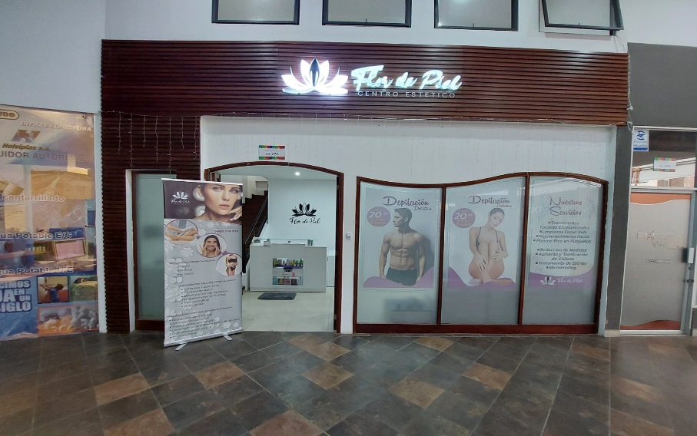
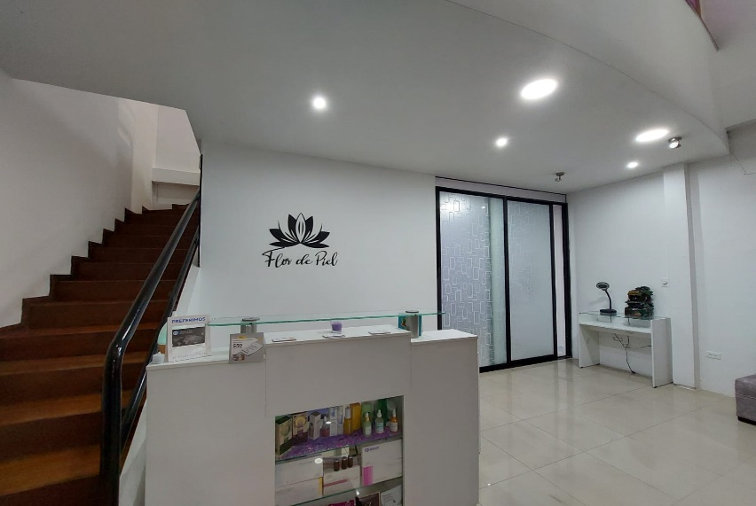
BACKGROUND:
A spa is defined as a place where a person attends to receive a treatment, therapies or relaxing activities.
Within a spa it is very important to define the types of service provided, but what are these?

Slide 4
TYPES OF SERVICE
TREATMENTS:
Facial treatment
Acne treatment
Stain blurring
Deep hydration
Chemical peeling
Platelet rich plasma
Reduction measures
Body toning
Blurring of stretch marks
Increasing of buttocks
Ionic detox
Microblanding
GENERAL SERVICE:
Laser depilation

Slide 5
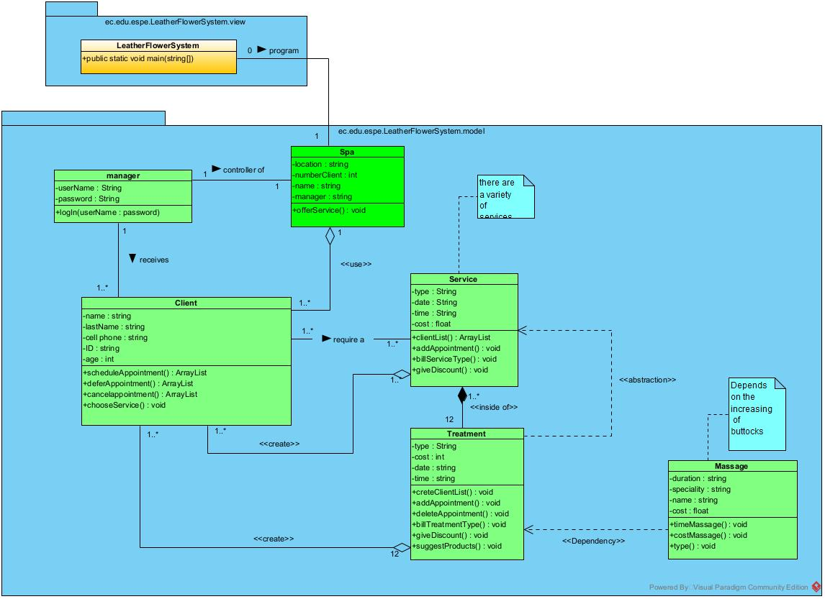
CASE DIAGRAM (UML)

Slide 6
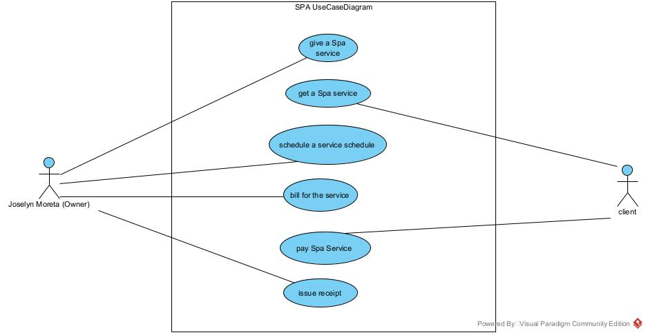
Use case DIAGRAM

Slide 7
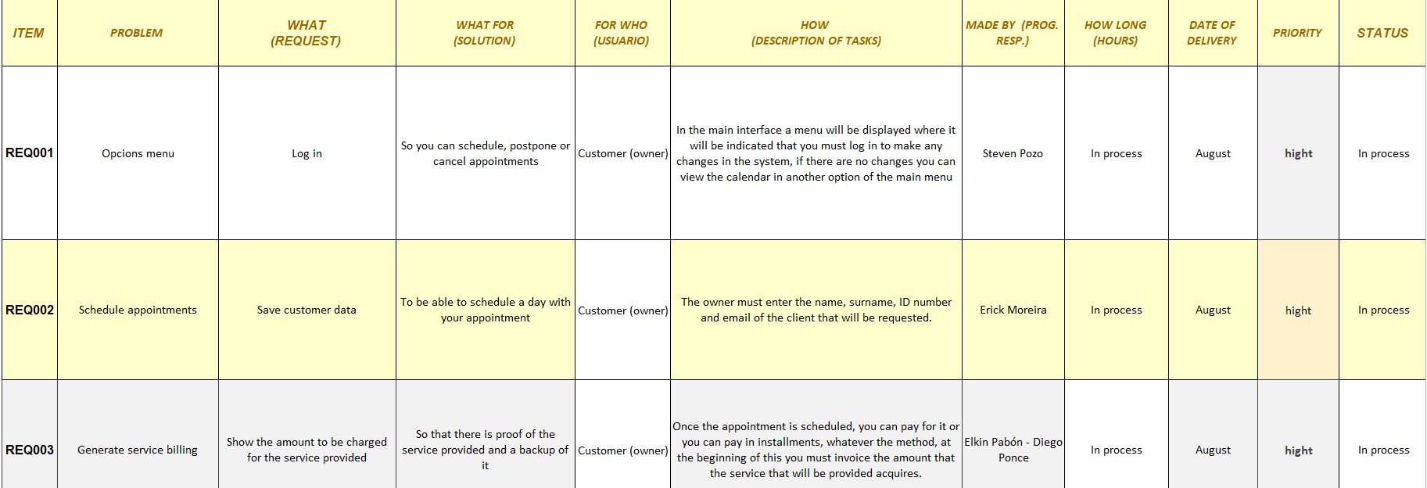
User histories OR REQUIREMENTS

Slide 8
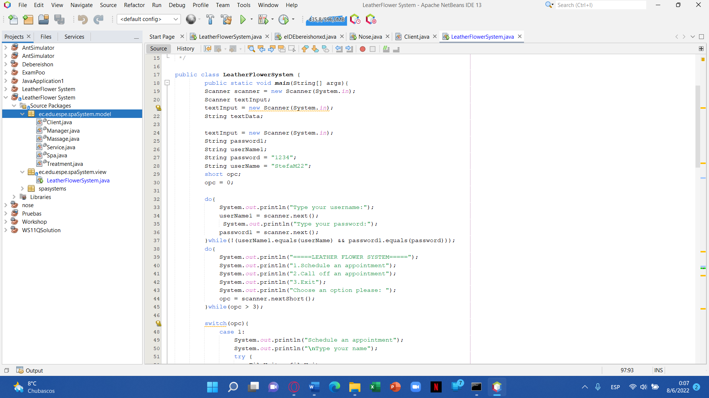
code

Slide 9
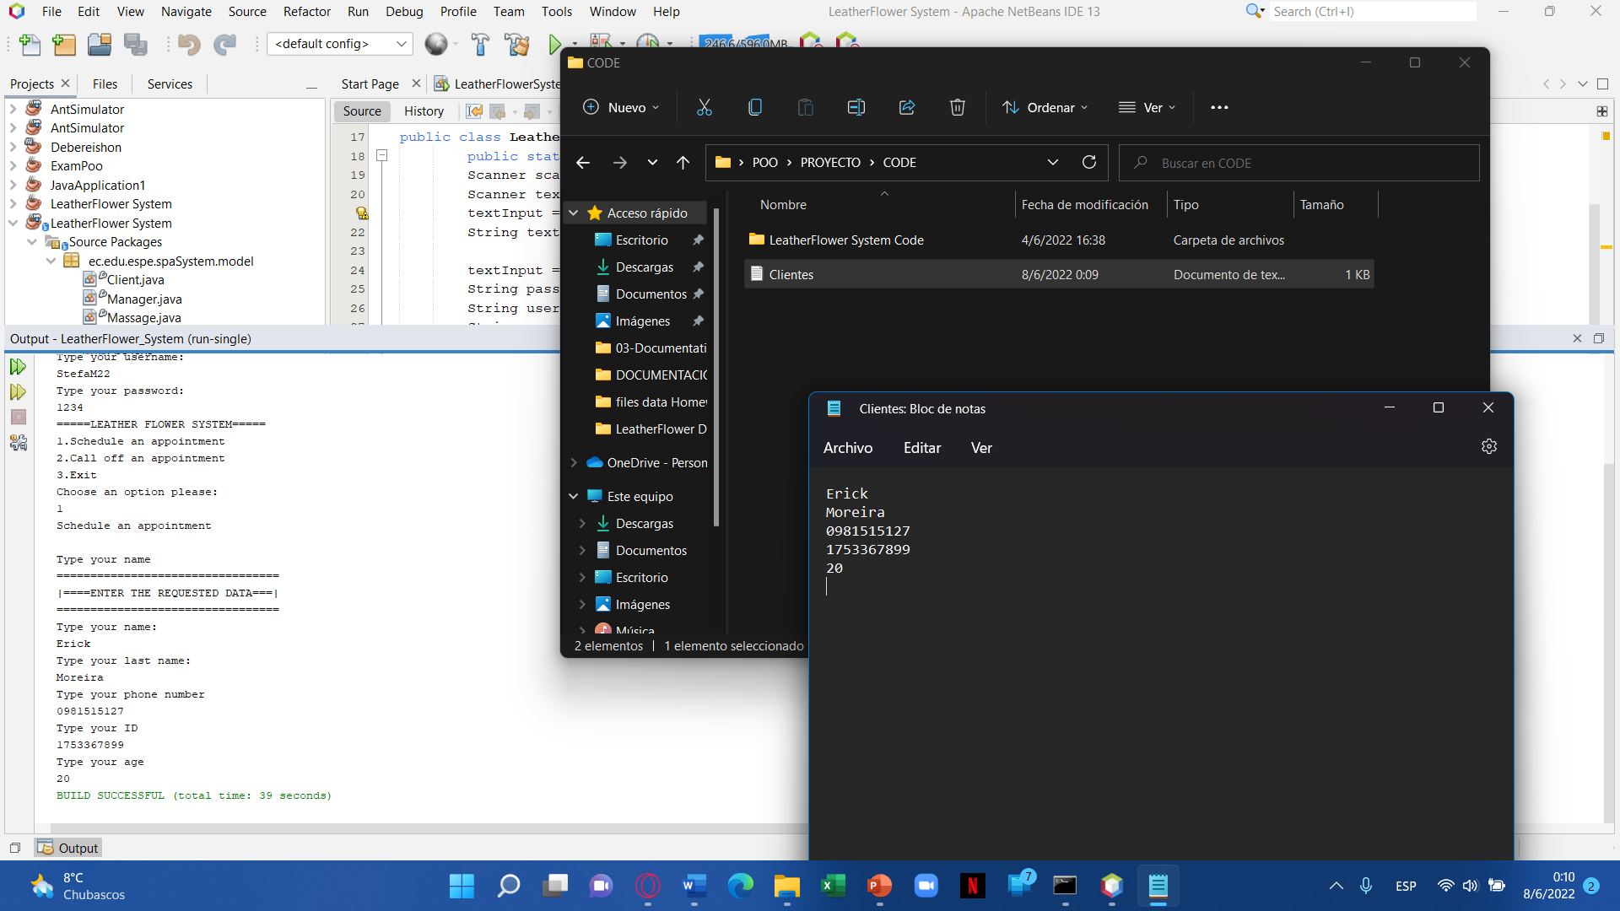

Slide 10
